Slide 1
Verilog HDL语言
主讲：胡迪青
Email：hudq024@mail.hust.edu.cn
QQ ：121374333
Tel ：15327191496

Slide 2
电路设计过程

Slide 3
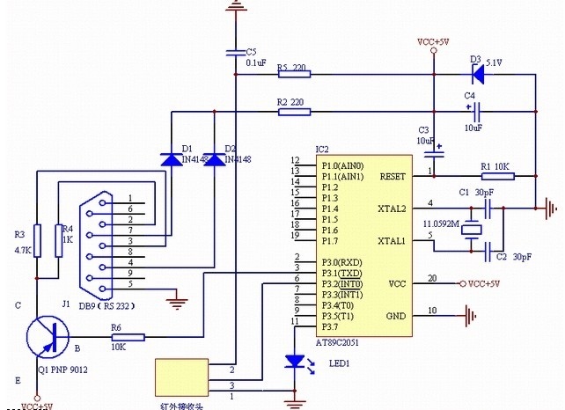
电路设计过程

Slide 4
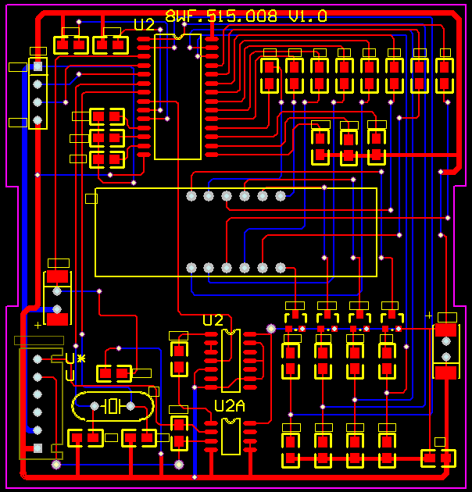
电路设计过程

Slide 5
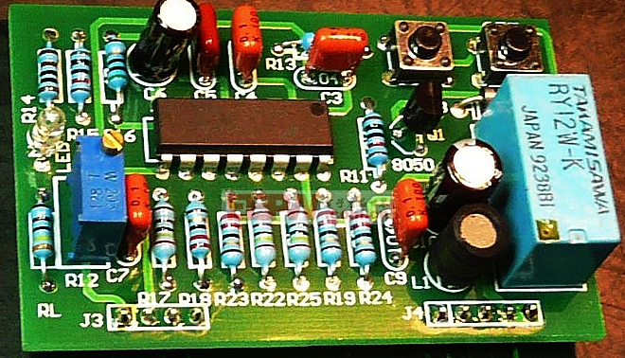
电路设计过程

Slide 6
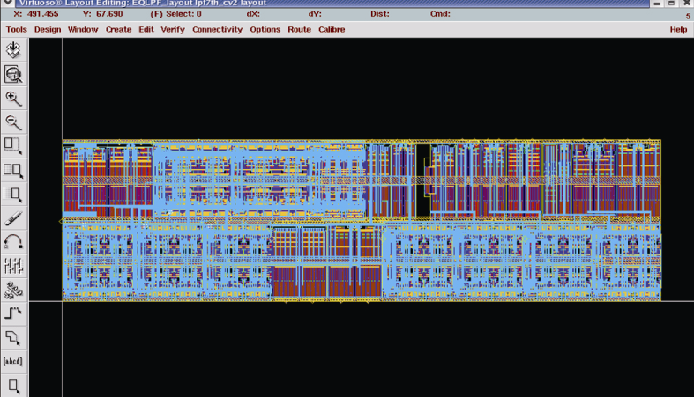
电路设计过程

Slide 7
硬件描述语言概述
硬件描述语言（Hardware Description Language，HDL）是硬件设计人员和电子设计自动化（EDA）工具之间的界面。
主要目的是用来编写设计文件，建立电子系统的仿真模型。
通过仿真，然后再自动综合以生成符合要求且在电路结构上可以实现的数字逻辑网表（Netlist）。
根据网表和某种工艺的器件自动生成具体电路，然后生成该工艺条件下这种具体电路的延时模型。
仿真验证无误后，用于制造ASIC芯片或写入CPLD和FPGA等可编程器件中。

Slide 8
为何要学习和使用HDL语言
电路设计将继续保持向大规模和高复杂度发展的趋势，工程人员将不得不使用HDL进行设计，而把具体实现留给逻辑综合工具去完成。
电子领域的竞争越来越激烈，有效的HDL语言和计算机仿真系统在将设计错误的数目减少到最低限方面起到不可估量的作用，从而提高设计的效率、降低设计成本、缩短设计周期。
用HDL进行设计，只需要对描述语言进行修改，这比更改电路原理图要容易实现得多，使得探索各种设计方案变成一件很容易、很便利的事情。

Slide 9
HDL语言的发展历史
HDL于1982年提出。随后，许多高等学校、科研单位、大型计算机厂商都相继推出了各自的HDL 。
最终成为IEEE技术标准的仅有两个，即VHDL和Verilog HDL。
Verilog HDL在1983年首创，1995年12月定出Verilog HDL的标准IEEE 1364-1995。
Verilog一共发型了三个标准：Verilog-1995、Verilog-2001和Verilog-2005。

Slide 10
Verilog设计入门

Slide 11
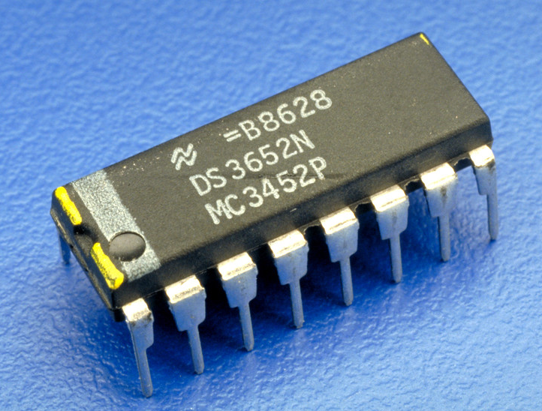
Verilog程序的最基本结构
模块（module）是Verilog的基本描述单位，用于描述某个设计的功能或结构，及其与其他模块通信（连接）的外部端口。
一个模块可以在另一个模块中使用。

Slide 12
Verilog程序的最基本结构
Verilog程序由关键词module和endmodule进行定义
Verilog HDL 大小写敏感
module name (port_list);
port declarations
data type declarations
functionality
timing specification
endmodule

Slide 13
Verilog程序的组成部分
module Name，
port list， port declarations（if ports present）
parameters（optional），
Declarations of wires,
regs and other variables
Data flow statements
( assign )
这5个组件的排列顺序是任意的，可以选择其中的一个或几个组件构成一个Verilog程序。
Instantiation of lower level modules
Tasks and functions
Always and initial blocks,
All behavioral statements go in these blocks.
endmodule

Slide 14
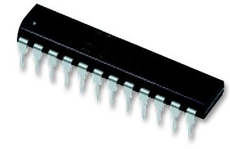
Verilog 模块
在Verilog语言中，一个电路就是一个module。
module name
ports names of module
module decoder_2_to_4 (A, D) ;
input [1:0] A ;
output [3:0] D ;
assign D = (A == 2'b00) ? 4'b0001 :
(A == 2'b01) ? 4'b0010 :
(A == 2'b10) ? 4'b0100 :
(A == 2'b11) ? 4'b1000 ;
endmodule
A[1:0]
port types
port sizes
2
Decoder
2-to-4
module contents
4
D[3:0]
keywords underlined

Slide 15
Verilog 模块
Verilog语言的关键词不能用作模块名，（例如：module/port/signal 等）
Choose a descriptive module name
定义模块的端口（connectivity）
定义模块内部连接到端口的信号类型
Choose descriptive signal names
定义内部信号
描述模块内部实现的功能（ functionality）

Slide 16
定义端口
每个端口都会连接一个信号（Signal）
申明端口的类型
input
output
inout （双向）
Scalar (single bit) - 不需要给出信号的位数
input cin;
Vector (multiple bits) - 需要定义具体的位数
Range is MSB to LSB (left to right)
Do not have to include zero if you do not want to… (D[2:1])
output [7:0] OUT;
input [0:4] IN;

Slide 17
模块端口列表
模块端口的多种申明方法
module Add_half(c_out, sum, a, b);
output sum, c_out;
input a, b;
…
endmodule
module Add_half(output c_out, sum, input a, b);
…
endmodule
module xor_8bit(out, a, b);
output [7:0] out;
input [7:0] a, b;
…
endmodule
module xor_8bit(output [7:0] out, input [7:0] a, b);
…
endmodule

Slide 18
结构描述
一般使用内部元件（Primitive）、或自定义的下层模块对电路进行描述。
主要用于层次化设计中。
module mux2_1(out1,a,b,sel);
output out1;
input a,b,sel;
not (sel_, sel);
and (a1, a, sel_);
and (b1, b, sel_);
or (out1, a1, b1);
endmodule

Slide 19
数据流描述
一般使用连续赋值assign语句描述。
主要用于组合逻辑电路建模。
module mux2_1(out1, a, b, sel) ;
output out1;
input a, b;
input sel;
assign out1=(sel & b) | (~sel & a);
endmodule

Slide 20
行为描述
一般使用Initial或Always语句描述。
可以对组合、时序逻辑电路建模。
module mux2_1(out1, a, b, sel) ;
output reg out1;
input a, b;
input sel;
always @(sel or a or b)
begin
if (sel)
out1 = b;
else
out1 = a;
end
endmodule
module mux2_1(out1, a, b, sel) ;
output reg out1;
input a, b;
input sel;
always @(sel or a or b)
begin
case (sel)
1’b0 : out1 = a;
1’b1 : out1 = b;
endcase
end
endmodule

Slide 21
混合设计描述
结构、数据流和行为描述方式可以自由混合。
模块描述中可以包含实例化的门、模块实例化语句、连续赋值语句以及a l w a y s语句和i n i t i a l语句的混合。
但是，它们之间不可以相互包含。
来自a l w a y s语句和i n i t i a l语句（切记只有寄存器类型数据可以在这两种语句中赋值）的值能够驱动门或开关。
而来自于门或连续赋值语句（只能驱动线网）的值能够反过来用于触发a l w a y s语句和i n i t i a l语句。

Slide 22
混合设计实例：1位全加器
module FA_Mix(A,B,Cin,Sum,Cout);
input A,B,Cin;
output Sum,Cout;
reg Cout;
reg T1,T2,T3;
wire S1;
xor X1(S1,A,B); //门实例语句
always @ (A or B or Cin) //always 语句
begin
T1 = A & B;
T2 = A & Cin;
T3 = B & Cin;
Cout = (T1 | T2) | T3;
end
assign Sum = S1 ^ Cin; //连续赋值语句
endmodule

Slide 23
设计验证与仿真
Verilog HDL不仅提供描述设计的能力，而且提供对激励、控制、存储响应和设计验证的建模能力。
激励和控制可用初始化语句产生。验证运行过程中的响应可以作为“变化时保存”或作为选通的数据存储。
最后，设计验证可以通过在初始化语句中写入相应的语句自动与期望的响应值比较完成。
残酷的现实……
设计用时10%，而用于设计验证的时间则占 90%
如果方法不当验证用时甚至更多

Slide 24
HDL电路的仿真与验证
要测试一个设计块是否正确，就要用Verilog再写一个测试模块。
这个测试模块应包括以下三个方面的内容：
测试模块中要调用到设计块，只有这样才能对它进行测试；
测试模块中应包含测试的激励信号源；
测试模块能够实施对输出信号的检测，并报告检测结果。
Testbenchs也是用Verilog语言写的。
Testbench Verilog不是用来描述硬件的，更像是一个测试程序。
Stimulus
Generation
(verilog)
Design
Under Test
(verilog)
Output
Monitoring
Self Checking
(verilog)
file
Verilog test bench shell
file

Slide 25
Testbench实例（仅用于演示）
module test_and;
integer file, i, code;
reg a, b, expect, clock;
wire out;
parameter cycle = 20;
and #4 a0(out, a, b); // Circuit under test
initial begin : file_block
clock = 0;
file = $fopen("compare.txt", “r” );
for (i = 0; i < 4; i=i+1) begin
@(posedge clock) // Read stimulus on rising clock
code = $fscanf(file, "%b %b %b\n", a, b, expect);
#(cycle - 1) // Compare just before end of cycle
if (expect !== out)
$strobe("%d %b %b %b %b", $time, a, b, expect, out);
end // for
$fclose(file); $stop;
end // initial
always #(cycle /2) clock = ~clock; // Clock generator
endmodule

Slide 26
Verilog语言基础

Slide 27
Verilog语言基础
间隔符：空格、TAB键、换行符及换页符
注释
单行注释用//标志起头和回车符结尾
多行注释用/*标志起头和*/标志结尾
标识符
用来对信号进行命名（命名要规范）；
可以是任意一组字母、数字、$符号和_(下划线)符号的组合；
必须是由字母或下划线开头，长度小于1024字符；
转义标识符以反斜杠“\”开头，以空白符结尾的任何字符序列；
标识符区分大、小写。
关键词：Verilog HDL 内部已使用的词，关键词都是小写。
格式：区分大小写。自由格式，即结构可以跨越多行编写。

Slide 28
Verilog语言基础
四种基本的值
0：逻辑0或“假”
1：逻辑1或“真”
x：未知
z：高阻
三类常量
整型数：简单的十进制格式，基数格式（5’o37，4’b1x_01）
实数：十进制计数法，科学计数法
字符串：字符串是双引号的字符序列，字符串不能分成多行书写
参数
参数是一个常量，经常用于定义时延和变量的宽度等。
信号等级 | 信 号 强 度 | 关 键 字
7 | Supply Drive | supply0 | supply1
6 | Strong Drive | strong0 | strong1
5 | Pull Drive | pull0 | pull1
4 | Large Capacitance | large
3 | Weak Drive | weak0 | weak1
2 | Medium Capacitance | medium
1 | Small Capacitance | small
0 | Hi Impedance (no drive) | highz0 | highz1

Slide 29
Verilog语言基础
数据类型
线网类型（wire）。表示Verilog结构化元件间的物理连线。它的值由驱动元件的值决定；如果没有驱动元件连接到线网，线网的缺省值为z。
寄存器类型（reg）。表示一个抽象的数据存储单元，它只能在always语句和initial语句中被赋值，并且它的值从一个赋值到另一个赋值被保存下来。寄存器类型的变量具有x的缺省值。

Slide 30
Verilog语言基础
系统任务和函数
以$字符开始的标识符表示系统任务或系统函数；
任务提供了一种封装行为的机制，任务可以返回0个或多个值；
函数除只能返回一个值以外与任务相同；
函数在0时刻执行，即不允许延迟，而任务可以带有延迟。
编译指令：以`（反引号）开始的某些标识符
`define和`undef，`ifdef、`else和 `endif，`default_nettype
`include，`resetall，`timescale
`unconneted_drive和`nounconnected_drive
`celldefine和`endcelldefine

Slide 31
Verilog语言基础
运算符（9类）
算术运算符： +、-、*、/、%
位运算符： ~、&、|、^、^~、~^
缩位运算符（单目）： &、~&、|、~|、^、^~、~^
逻辑运算符： !、&&、||
关系运算符（双目）： <、>、<=、>=
相等与全等运算符： ==、!=、===、!==
逻辑移位运算符： <<、>>
连接运算符： { }
条件运算符： ? :

Slide 32
Verilog语言基础
缩位运算符：对Vector中的所有位进行相同的操作，最后生成一个一位的信号。
缩位“与”
assign all_ones = &accumulator; // are all bits set?
缩位“或”
assign not_zero = |accuumulator; // are any bits set?
缩位“异或”
assign parity = ^data_out; // even parity bit

Slide 33
Verilog语言基础
连接运算符{ }（相当于集线器）
becomes 8-bit vector:
a₁a₀b₁b₀c₁c₀da₂
module concatenate(out, a, b, c, d);
input [2:0] a;
input [1:0] b, c;
input d;
output [9:0] out;
assign out = {a[1:0],b,c,d,a[2]};
endmodule
Slide taken direct from Eric Hoffman

Slide 34
Verilog语言基础
false_expr
0
out
条件运算符?：
true_expr
1
cond_expr
Examples:
// a 2:1 mux
assign out = select ? in0 : in1;
// tri-state bus
assign src1 = rf2src1 ? Mem[addr1] : 16’hzzzz;
// Either true_expr or false_expr can also be a conditional operator
// lets use this to build a 4:1 mux
assign out = sel[1] ? (sel[0] ? in3 : in2) : (sel[0] ? in1 : in0);
Slide taken direct from Eric Hoffman

Slide 35
Verilog程序设计方法

Slide 36
1位全加器实例：三种描述方法

Slide 37
1位全加器的结构描述
module full_add (A, B, Cin, Sum, Cout) ;
input A, B, Cin ;
output Sum, Cout ;
wire S1, T1, T2, T3, C1;
xor X1 (S1, A, B);
xor X2 (Sum, S1, Cin);
and A1 (T1, A, B);
and A2 (T2, A, Cin);
and A3 (T3, B, Cin);
or O1 (C1, T1, T2);
or O2 (Cout, C1, T3);
endmodule

Slide 38
1位全加器的数据流描述
module fa_rtl (A, B, Cin, Sum, Cout) ;
input A, B, Cin ;
output Sum, Cout ;
// use continuous assignments
assign Sum = A ^ B ^ Cin;
assign Cout = (A & B) | (A & Cin) | (B & Cin);
endmodule
Data flow Verilog is
often very concise
and still easy to read
Works great for most
boolean and even
datapath descriptions
Slide taken direct from Eric Hoffman

Slide 39
1位全加器的行为描述
module fa_bhv (A, B, Cin, Sum, Cout) ;
input A, B, Cin;
output Sum, Cout;
reg Sum, Cout; // assignment made in an always block
// must be made to registers
// use procedural assignments
always@(A or B or Cin)
begin
Sum = A ^ B ^ Cin;
Cout = (A & B) | (A & Cin) | (B & Cin);
end
endmodule
Slide taken direct from Prof. Schulte

Slide 40
1位全加器的混合描述
module FA_Mix(A,B,Cin,Sum,Cout);
input A,B,Cin;
output Sum,Cout;
reg Cout;
reg T1,T2,T3;
wire S1;
xor X1(S1,A,B); //门实例语句
always @ (A or B or Cin) //always 语句
begin
T1 = A & B;
T2 = A & Cin;
T3 = B & Cin;
Cout = (T1 | T2) | T3;
end
assign Sum = S1 ^ Cin; //连续赋值语句
endmodule

Slide 41
结构描述
用于层次化模块设计
内部元件（Primitives）
子模块（内部还可以包括其它子模块）
自顶向下（top-down）进行设计
自下往上（bottom-up）进行实现和验证

Slide 42
结构描述
Full Adder Hierarchy
Add_full
Add_half
Add_half
or
xor
and
xor
and

Slide 43
结构描述
Full Adder Hierarchy
Add_full
Add_half
Add_half
or
xor
and
xor
and
module Add_half(c_out, sum, a, b);
output sum, c_out;
input a, b;
xor sum_bit(sum, a, b);
and carry_bit(c_out, a, b);
endmodule

Slide 44
结构描述
Full Adder Hierarchy
Add_full
Add_half
Add_half
or
xor
and
xor
and
module Add_full(c_out, sum, a, b, c_in) ;
output sum, c_out;
input a, b, c_in;
wire w1, w2, w3;
Add_half AH1(.sum(w1), .c_out(w2), .a(a), .b(b));
Add_half AH2(.sum(sum), .c_out(w3), .a(c_in), .b(w1));
or carry_bit(c_out, w2, w3);
endmodule

Slide 45
结构描述
模块实例化：根据位置连线
module dec_2_4_en (A, E_n, D);
input [1:0] A;
input E_n;
output [3:0] D;
.
.
.
wire [1:0] X;
wire W_n;
wire [3:0] word;
// instantiate decoder
dec_2_4_en DX (X, W_n, word);
Partial code instatiating decoder

Slide 46
结构描述
模块实例化：根据名称连线
module dec_2_4_en (A, E_n, D);
input [1:0] A;
input E_n;
output [3:0] D;
.
.
.
wire [1:0] X;
wire W_n;
wire [3:0] word;
// instantiate decoder
dec_2_4_en DX (.A(X), .E_n(W_n), .D(word));
Partial code instatiating decoder

Slide 47
结构描述
模块实例化：悬空的连线
Example: module dec_2_4_en(A, E_n, D);
dec_2_4_en DX (X[1:0], , word); // E_n is high impedence (z)
dec_2_4_en DX (X[1:0], W_n , ); // Outputs D[3:0] unused
General rules
Empty input ports => high impedance state (z)
Empty output ports => output not used
Specify all input ports anyway!
z as an input is very bad…why?
Helps if no connection to output port name but leave empty:
dec_2_4_en DX(.A(X[3:2]), .E_n(W_n), .D());

Slide 48
数据流描述
描述方法
通常用法：assign <LHS> = <RHS expression>;
If RHS result changes, LHS is updated with new value
Constantly operating (“continuous”)
It is hardware!
RHS can use operators (i.e. +,-,&,|,^,~,>>,…)
assign [drive_strength] [delay] list_of_net_assignments;
Where:
list_of_net_assignment ::= net_assignment [{,net_assignment}]
& Where:
Net_assignment ::= net_lvalue = expression

Slide 49
数据流描述
数据流描述举例
Simplest form:
// out is a net, a & b are also nets
assign out = a & b; // and gate functionality
Using vectors：
wire [15:0] result, src1, src2; // 3 16-bit wide vectors
assign result = src1 ^ src2; // 16-bit wide XOR
Can you implement a 32-bit adder in a single line?
wire [31:0] sum, src1, src2; // 3 32-bit wide vectors
assign {c_out,sum} = src1 + src2 + c_in; // wow!

Slide 50
行为描述
initial and always form basis of all behavioral Verilog
All other behavioral statements occur within these
initial and always blocks cannot be nested
All <LHS> assignments must be to type reg
initial statements start at time 0 and execute once
If there are multiple initial blocks they all start at time 0 and execute independently. They may finish independently.
If multiple behavioral statements are needed within the always/initial statement then the always/initial statement can be made compound with use of begin/end

Slide 51
More on initial statements
Initial statement very useful for testbenches
Initial statements do not synthesize
Do not use them in DUT Verilog (stuff you intend to synthesize)

Slide 52
initial Blocks
`timescale 1 ns / 100 fs
module full_adder_tb;
reg [3:0] stim;
wire s, c;
full_adder DUT(sum, carry, stim[2], stim[1], stim[0]); // instantiate DUT
// monitor statement is special - only needs to be made once,
initial $monitor(“%t: s=%b c=%b stim=%b”, $time, s, c, stim[2:0]);
// tell our simulation when to stop
initial #50 $stop;
initial begin // stimulus generation
for (stim = 4’h0; stim < 4’h8; stim = stim + 1) begin
#5;
end
end
endmodule
all initial blocks start at time 0
multi-statement block enclosed by begin and end

Slide 53
Another initial Statement Example
module stim();
reg m,a,b,x,y;
initial
m = 1’b0;
initial begin
#5 a = 1’b1;
#25 b = 1’b1;
end
initial begin
#10 x = 1’b1;
#25 y = 1’b1;
end
initial
#50 $finish;
endmodule
Time
Event
0
m = 1’b0
5
a = 1’b1
Model sim
10
x = 1’b1
30
b = 1’b1
35
y = 1’b1
50
$finish
What events at what times will a verilog simulator produce?

Slide 54
always statements
Behavioral block operates CONTINUOUSLY
Executes at time zero but loops continuously
Can use a trigger list to control operation; @(a, b, c)
In absense of a trigger list it will re-evaluate when the last <LHS> assignment completes
module clock_gen (output reg clock);
initial
clock = 1’b0; // must initialize in initial block
always // no trigger list for this always
#10 clock = ~clock; // always will re-evaluate when
// last <LHS> assignment completes
endmodule

Slide 55
always vs initial
reg [7:0] v1, v2, v3, v4;
initial begin
v1 = 1;
#2 v2 = v1 + 1;
v3 = v2 + 1;
#2 v4 = v3 + 1;
v1 = v4 + 1;
#2 v2 = v1 + 1;
v3 = v2 + 1;
end
reg [7:0] v1, v2, v3, v4;
always begin
v1 = 1;
#2 v2 = v1 + 1;
v3 = v2 + 1;
#2 v4 = v3 + 1;
v1 = v4 + 1;
#2 v2 = v1 + 1;
v3 = v2 + 1;
end

Slide 56
Trigger lists (Sensitivity lists)
Conditionally“execute”inside of always block
Any change on trigger (sensitivity) list, triggers block
always @(a, b, c) begin
…
end
Original way to specify trigger list always @ (X1 or X2 or X3)
In Verilog 2001 can use , instead of or always @ (X1, X2, X3)
Verilog 2001 also has * for combinational only always @ (*)

Slide 57
行为描述程序结构
if-else 条件语句
case 语句
for 循环语句
if (条件表达式) 块语句1
else if (条件表达式2) 块语句2
……
else if (条件表达式n) 块语句n
else 块语句n+1
case (敏感表达式)
值1： 块语句1
值2： 块语句2
……
值n： 块语句n
default：块语句n+1
endcase
for (表达式1；表达式2；表达式3）块语句

Slide 58
if…else statement
If (condition) begin
<statement1>;
<statement2>;
end
If (condition)
begin
<statement1>;
<statement2>;
end
else
begin
<statement3>;
<statement4>;
end
If (condition)
begin
<statement1>;
<statement2>;
end
else if (condition2)
begin
<statement3>;
<statement4>;
end
else
begin
<statement5>;
<statement6>;
end
Of course the compound statements formed with begin/end are optional
Multiple else if’s can be strung along indefinitely

Slide 59
How does if…else statement synthesize?
Does not conditionally“execute”block of“code”
Does not conditionally create hardware!
It makes a multiplexer or selecting logic
Generally:
Hardware for both paths is created
Both paths“compute”simultaneously
The result is selected depending on the condition
if (func_add)
alu = a + b;
else if (func_and)
alu = a & b;
else
alu = 8’h00;
+
alu
a[7:0]
1
&
0
8
1
b[7:0]
8’h00
0
8
func_and
func_add

Slide 60
if statement synthesis (continued)
if (a)
func = c & d;
else if (b)
func = c | d;
c
d
1
d
0
q
func
How does this
synthesize?
en
a
b
Latch??
What you ask for is what you get!
func is of type register. When neither a or b are asserted it didn’t not get a new value.
That means it must have remained the value it was before.
That implies memory…i.e. a latch!
Always have an
else to any if to avoid unintended
latches.

Slide 61
More on if statements…
Watch the sensitivity lists…what is missing in this example?
always @(a, b) begin
temp = a – b;
if ((temp < 8’b0) && abs)
out = -temp;
else out = temp;
end
always @ (posedge clk) begin
if (reset) q <= 0;
else if (set) q <= 1;
else q <= data;
end
What is being coded here?
Is it synchrounous or asynch?
Does the reset or the set have
higher priority?

Slide 62
case Statements
Verilog has three types of case statements:
case, casex, and casez
General form of case
case (expression)
alternative1 : statement1; // any of these statements could
alternative2 : statement2; // be a compound statement using
alternative3 : statement3; // begin/end
default : statement4 // always use default for synth stuff
endcase

Slide 63
case Statements
Example
parameter AND = 2’b00;
parameter OR = 2’b01;
parameter XOR = 2’b10;
case (alu_op)
AND : alu = src1 & src2;
OR : alu = src1 | src2;
XOR : alu = src1 ^ src2;
default : alu = src1 + src2;
endcase
Why always have a default?
Same reason as always having an else with an if statement.
All cases are specified, therefore no unintended latches.
Slide taken direct from Eric Hoffman

Slide 64
Loops in Verilog
for loop:
There are 3 other loops available:
while loop
repeat loop
forever loop
reg [15:0] rf[0:15]; // memory structure for modeling register file
reg [5:0] w_addr; // address to write to
for (w_addr=0; w_addr<16; w_addr=w_addr+1)
rf[w_addr[3:0]] = 16’h0000; // initialize register file memory
initial begin
clk = 0;
forever #10 clk = ~ clk;
end
Clock generator is by far the most
common use of a forever loop

Slide 65
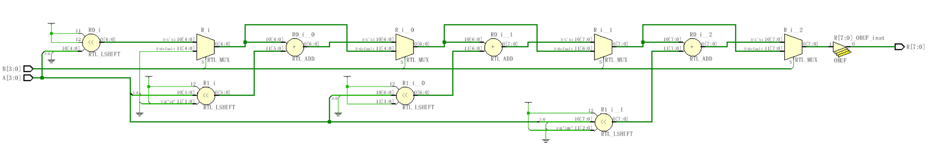
Loops in Verilog
module mult4b(output reg [7:0] R, input [3:0] A, input [3:0] B);
integer i;
always @(A, B) begin
R = 0;
for(i=1; i<=4; i=i+1)
if(B[i-1]) R = R + (A<<i);
end
endmodule

Slide 66
赋值语句
赋值语句的基本形式：
三种赋值语句
连续赋值语句
只要输入端操作数的值发生变化，该语句就重新计算并刷新赋值结果。用关键词assign来区分。
阻塞型过程赋值
赋值算符“＝” ：前一条语句没有完成赋值过程之前，后面的语句不可能被执行。
非阻塞型过程赋值
赋值算符“<＝” ：一条非阻塞型赋值语句的执行，并不会影响块中其它语句的执行。
基本形式：<寄存器变量>＝<表达式>；
外部模式：<定时控制> <寄存器变量>＝<表达式>；
内部模式：<寄存器变量>＝ <定时控制> <表达式>；
定时控制分为两类：延时控制
事件控制 @(事件控制敏感表）

Slide 67
Blocking vs non-Blocking
Blocking“Evaluated”sequentially
Works a lot like software (danger!)
Used for combinational logic
module addtree(output reg [9:0] out, input [7:0] in1, in2, in3, in4);
reg [8:0] part1, part2;
always @(in1, in2, in3, in4) begin
part1 = in1 + in2;
part2 = in3 + in4;
out = part1 + part2;
end
endmodule
in1
in2
in3
in4
+
+
part1
part2
+
out
Slide taken direct from Eric Hoffman

Slide 68
Non-Blocking Assignments
“Updated”simultaneously if no delays given
Used for sequential logic
module swap(output reg out0, out1, input rst, clk);
always @(posedge clk) begin
if (rst) begin
out0 <= 1’b0;
out1 <= 1’b1;
end
else begin
out0 <= out1;
out1 <= out0;
end
end
endmodule
D Q
rst to 0
out0
rst
clk
D Q
rst to 1
out1
Slide taken direct from Eric Hoffman

Slide 69
Swapping if done in Blocking
In blocking, need a“temp”variable
module swap(output reg out0, out1, input in0, in1, swap);
reg temp;
always @(*) begin
out0 = in0;
out1 = in1;
if (swap) begin
temp = out0;
out0 = out1;
out1 = temp;
end
end
endmodule
Which values get included on the sensitivity list from *?
in0
in1
out0
swap
out1
Slide taken direct from Eric Hoffman

Slide 70
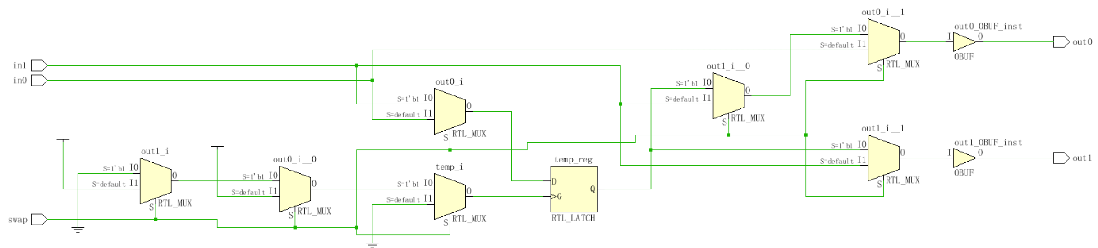
Swapping if done in Non-Blocking
module swap(output reg out0, out1, input in0, in1, swap);
reg temp;
always @(*) begin
out0 <= in0;
out1 <= in1;
if (swap) begin
temp <= out0;
out0 <= out1;
out1 <= temp;
end
end
endmodule

Slide 71
More on Blocking
Called blocking because….
The evaluation of subsequent statements <RHS> are blocked, until the <LHS> assignment of the current statement is completed.
module pipe(clk, d, q);
input clk,d;
output q;
reg q;
always @(posedge clk) begin
q1 = d;
q2 = q1;
q3 = q2;
end
endmodule
q1
q2
q3
d
clk
Lets code this
Simulate this in your head…
Remember blocking behavior of: <LHS> assigned before <RHS> of next evaluated.
Does this work as intended?
Slide taken direct from Eric Hoffman

Slide 72
More on Non-Blocking
Lets try that again
module pipe(clk, d, q);
input clk,d;
output q;
reg q;
always @(posedge clk) begin
q1 <= d;
q2 <= q1;
q3 <= q2;
end
endmodule;
q1
q2
q3
d
clk
Lets code this
With non-blocking statements the <RHS> of subsequent statements are not blocked. They are all evaluated simultaneously.
The assignment to the <LHS> is then scheduled to occur.
This will work as intended.
Slide taken direct from Eric Hoffman

Slide 73
Blocking vs non-Blocking
So Blocking is no good and we should always use Non-Blocking?
Consider combinational logic
module ao4(z,a,b,c,d);
input a,b,c,d;
output z;
reg z,tmp1,tmp2;
always @(a,b,c,d) begin
tmp1 <= a & b;
tmp2 <= c & d;
z <= tmp1 | tmp2;
end
endmodule
The inputs (a,b,c,d) in the sensitivity list change, and the always block is evaluated.
New assignments are scheduled for tmp1 & tmp2 variables.
A new assignment is scheduled for z using the previous tmp1 & tmp2 values.
Does this work?
Slide taken direct from Eric Hoffman

Slide 74
Blocking vs non-Blocking
Can we make this example work?
What is the downside of this?
Why not non-Blocking for Combinational！
module ao4(z,a,b,c,d);
input a,b,c,d;
output z;
reg z,tmp1,tmp2;
always @(a,b,c,d) begin
tmp1 <= a & b;
tmp2 <= c & d;
z <= tmp1 | tmp2;
end
endmodule
module ao4(z,a,b,c,d);
input a,b,c,d;
output z;
reg z,tmp1,tmp2;
always @(a,b,c,d,tmp1,tmp2) begin
tmp1 <= a & b;
tmp2 <= c & d;
z <= tmp1 | tmp2;
end
endmodule
Yes
Slide taken direct from Eric Hoffman

Slide 75
函数和任务
函数（function）的目的是通过返回一个值来响应输入信号的值。
任务（task）能支持多种目的，能计算多个结果值，这些结果值只能通过被调用的任务的输出端口送出。
任务和函数结构之间的差异：
一个任务块可以含有时间控制结构，而函数块则没有；
一个任务块可以有输入和输出，而函数块必须有至少一个输入，没有任何输出；
任务块的引发是通过一条语句，而函数块只有当它被引用在一个表达式中时才会生效。
function <位宽说明> 函数名；
输入端口与类型说明；
局部变量说明；
块语句
endfunction
task 任务名；
端口与类型说明；
局部变量说明；
块语句
endtask

Slide 76
时序控制
由“#”符号引入的延迟控制。它将程序的执行过程中断一定的时间，时间的长度由<time>的值来确定。
由“@”符号引入的事件控制。
等待语句。直到表达式计算为真之前，都延时下一个语句的执行。
延迟定义块。对模块中某一指定的路径进行延迟定义，这一路径连接模块的输入端口与输出端口（或双向端口）。
＃ <time> <statement> ；
@ (<posedge>|<negedge>|<signals> ) <statement>；
wait (<expression>) <statement> ；

Slide 77
Loading Memory Data From Files
This is very useful (memory modeling & testbenches)
$readmemb(“<file_name>”,<memory>);
$readmemb(“<file_name>”,<memory>,<start_addr>,<finish_addr>);
$readmemh(“<file_name>”,<memory>);
$readmemh(“<file_name>”,<memory>,<start_addr>,<finish_addr>);
module rom(input clk; input [15:0] addr; output [7:0] dout);
reg [7:0] mem[0:255]; // 8-bit wide 256 entry ROM
reg [7:0] dout;
initial
$readmemh(“constants”,mem);
always @(negedge clk) begin
dout <= mem[addr];
end
endmodule
// addr data
@0000 A2
@0001 B9
@0002 23
example “hex” file
//data
A2
B9
23
address is optional for the lazy

Slide 78
`Include Compiler Directives
`include filename
Inserts entire contents of another file at compilation
Can be placed anywhere in Verilog source
Can provide either relative or absolute path names
Example 1:
module use_adder8(…);
`include “adder8.v” // include the task for adder8
Example 2:
module cppc_dig_tb();
`include “/home/ehoffman/ece551/project/tb_tasks.v”
Useful for including tasks and functions in multiple modules

Slide 79
Verilog组合电路设计

Slide 80
组合电路分类
运算器
编码器（带优先级）
译码器
数据选择器
数据分配器
数值比较器

Slide 81
运算器
多位全加器
module full_adder(a, b, c, s);
parameter WIDTH = 8;
input [WIDTH-1:0] a, b;
output [WIDTH-1:0] s;
output c;
assign {c,s} = a + b;
endmodule

Slide 82
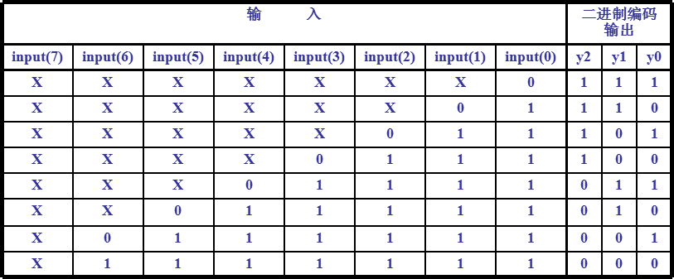
优先级编码器
常用于中断的优先级控制。例如，74LS148是一个8输入，3位二进制码输出的优先级编码器，当其某一个输入有效时，就可以输出一个对应的3位二进制编码。另外，当同时有几个输入有效时，将输出优先级最高的那个输入所对应的二进制编码。

Slide 83
优先级编码器
module Priority_Encoder(in, y);
input [7:0] in;
output reg [2:0] y;
always @(in) begin
if(in[0]==1'b0) y = 3'b111;
else if(in[1]==1'b0) y = 3'b110;
else if(in[2]==1'b0) y = 3'b101;
else if(in[3]==1'b0) y = 3'b100;
else if(in[4]==1'b0) y = 3'b011;
else if(in[5]==1'b0) y = 3'b010;
else if(in[6]==1'b0) y = 3'b001;
else y = 3'b000;
end
endmodule

Slide 84
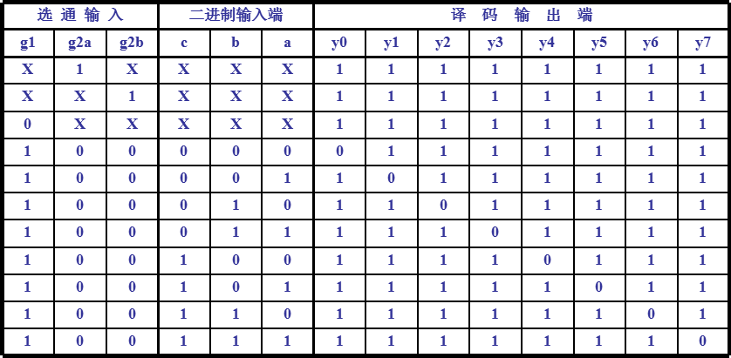
译码器
3-8译码器：3-8译码器是最常用的一种小规模集成电路。对输入a、b、c的值进行译码，就可以确定输出端y0～y7的哪一个输出端变为有效，从而达到译码的目的。

Slide 85
3-8译码器
module decoder_38(out,in,g1,g2a,g2b);
output reg [7:0] out;
input [2:0] in;
input g1,g2a,g2b;
always @(in,g1,g2a,g2b) begin
if(g1==1'b1 && g2a==1'b0 && g2b==1'b0)
case(in)
3'd0: out=8'b11111110;
3'd1: out=8'b11111101;
3'd2: out=8'b11111011;
3'd3: out=8'b11110111;
3'd4: out=8'b11101111;
3'd5: out=8'b11011111;
3'd6: out=8'b10111111;
3'd7: out=8'b01111111;
endcase
end
endmodule

Slide 86
多路选择器
多位数据宽度2选1多路选择器
module mux2_1(out1, a, b, sel) ;
output reg [3:0] out1;
input [3:0] a, b;
input sel;
always @(sel or a or b)
begin
if (sel)
out1 = b;
else
out1 = a;
end
endmodule
module mux2_1(out1, a, b, sel) ;
output reg [3:0] out1;
input [3:0] a, b;
input sel;
always @(sel or a or b)
begin
case (sel)
1’b0 : out1 = a;
1’b1 : out1 = b;
endcase
end
endmodule

Slide 87
多路选择器
4选1多路选择器
module MUX4_1(out, in0, in1, in2, in3, sel); output out; input in0, in1, in2, in3; input[1:0] sel; reg out;
always @ (*) begin if (sel==2'b00) out=in0; else if (sel==2'b01) out=in1; else if (sel==2'b10) out=in2; else out=in3; end
endmodule
module MUX4_1(out, in0, in1, in2, in3, sel); output out; input in0,in1,in2,in3; input[1:0] sel; reg out;
always @ (*) begin case(sel) 2'b00: out=in0; 2'b01: out=in1; 2'b10: out=in2; default: out=in3; endcase end
endmodule

Slide 88
数值比较器
module comparator(A, B, is_equal, is_great, is_less);
parameter WIDTH = 8;
input [WIDTH-1:0] A, B;
output is_equal, is_great, is_less;
assign is_equal = (A==B)? 1'b1 : 1'b0;
assign is_great = (A>B)? 1'b1 : 1'b0;
assign is_less = (A<B)? 1'b1 : 1'b0;
endmodule

Slide 89
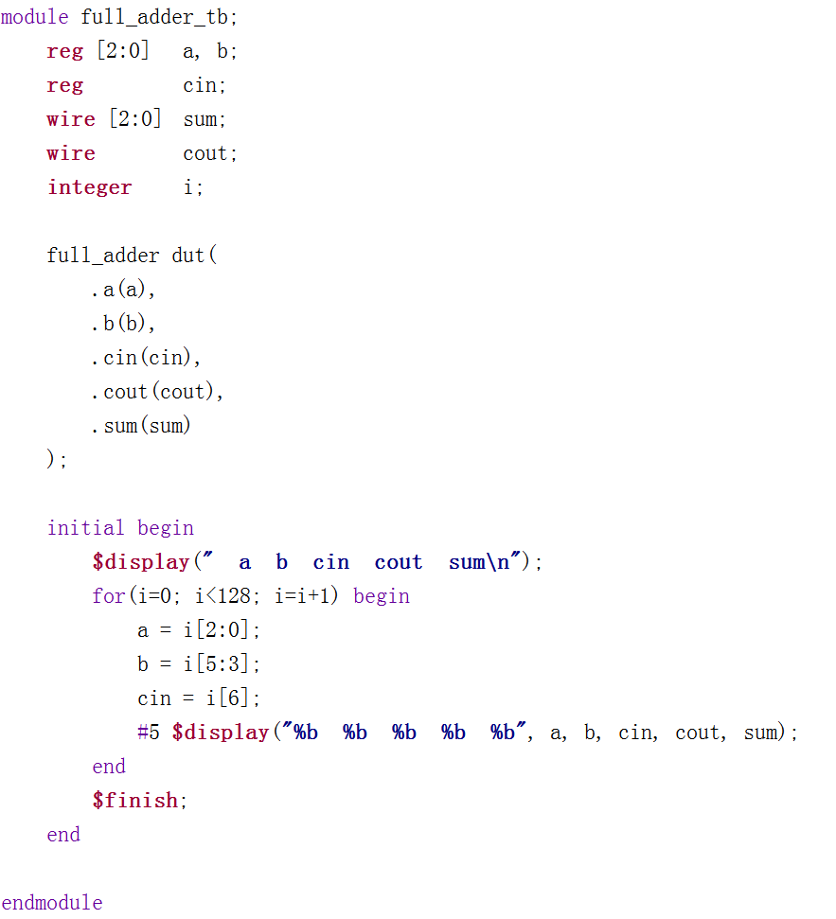
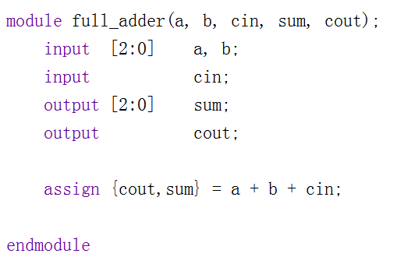
组合电路验证仿真

Slide 90
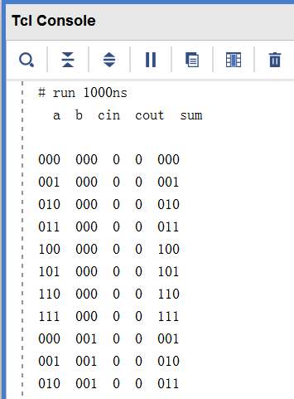
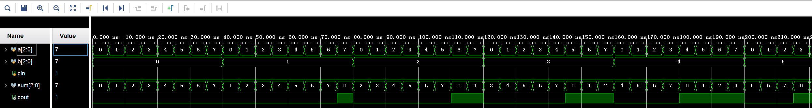
组合电路验证仿真

Slide 91
Verilog时序电路设计

Slide 92
时序电路分类
触发器（锁存器）
寄存器
计数器
存储器

Slide 93
触发器
基本D触发器及其Verilog表述

Slide 94
触发器
含异步复位和使能的D触发器及其Verilog表述

Slide 95
触发器
含同步复位控制的D触发器及其Verilog表述

Slide 96
计数器
简单加法计数器及其Verilog表述

Slide 97
寄存器
含同步预置功能的移位寄存器

Slide 98
存储器
双端口同步读写存储器
module dual_port_ram #(parameter DATA_WIDTH=8, parameter ADDR_WIDTH=6)(
input we, clk,
input [(ADDR_WIDTH-1):0] read_addr, write_addr,
input [(DATA_WIDTH-1):0] data,
output [(DATA_WIDTH-1):0] q);
reg [DATA_WIDTH-1:0] ram[2**ADDR_WIDTH-1:0];
reg [(DATA_WIDTH-1):0] q；
initial begin
$readmemh("ram_init.txt", ram);
end
always @ (posedge clk) begin
if (we) ram[write_addr] <= data; // Write
q <= ram[read_addr]; // Read
end
endmodule

Slide 99
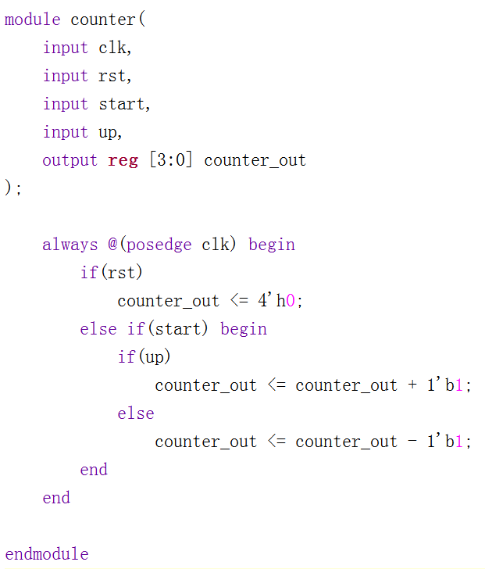
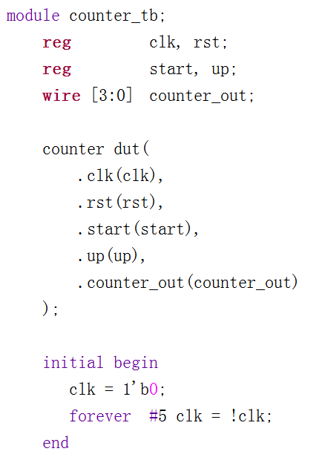
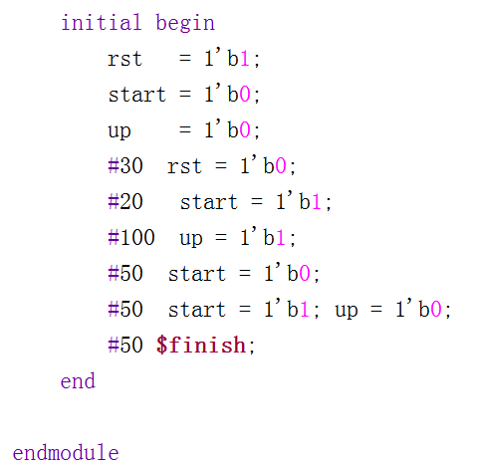
时序电路验证仿真

Slide 100
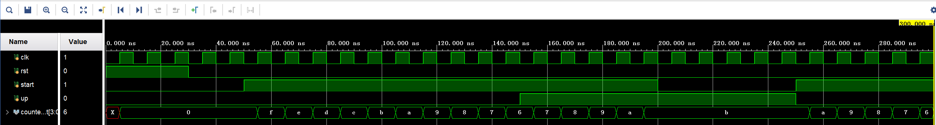
时序电路验证仿真

Slide 101
数据通路设计

Slide 102
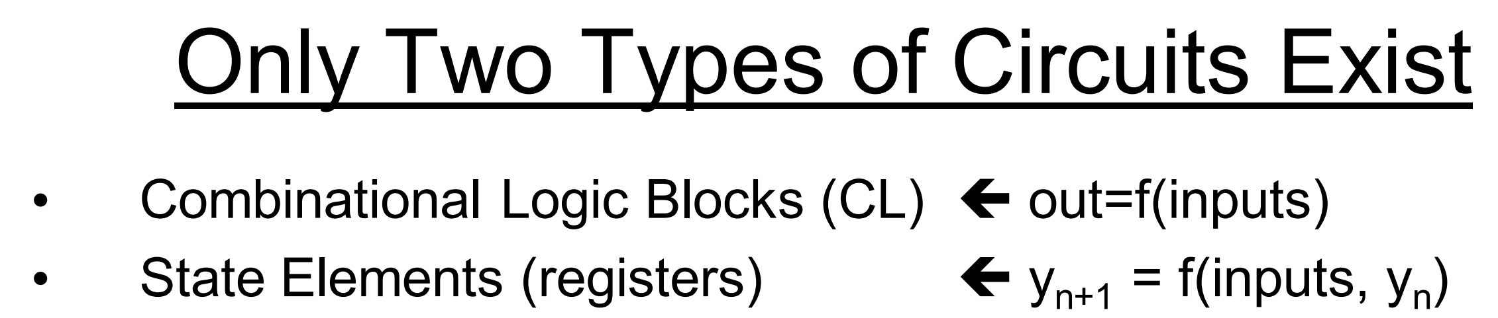
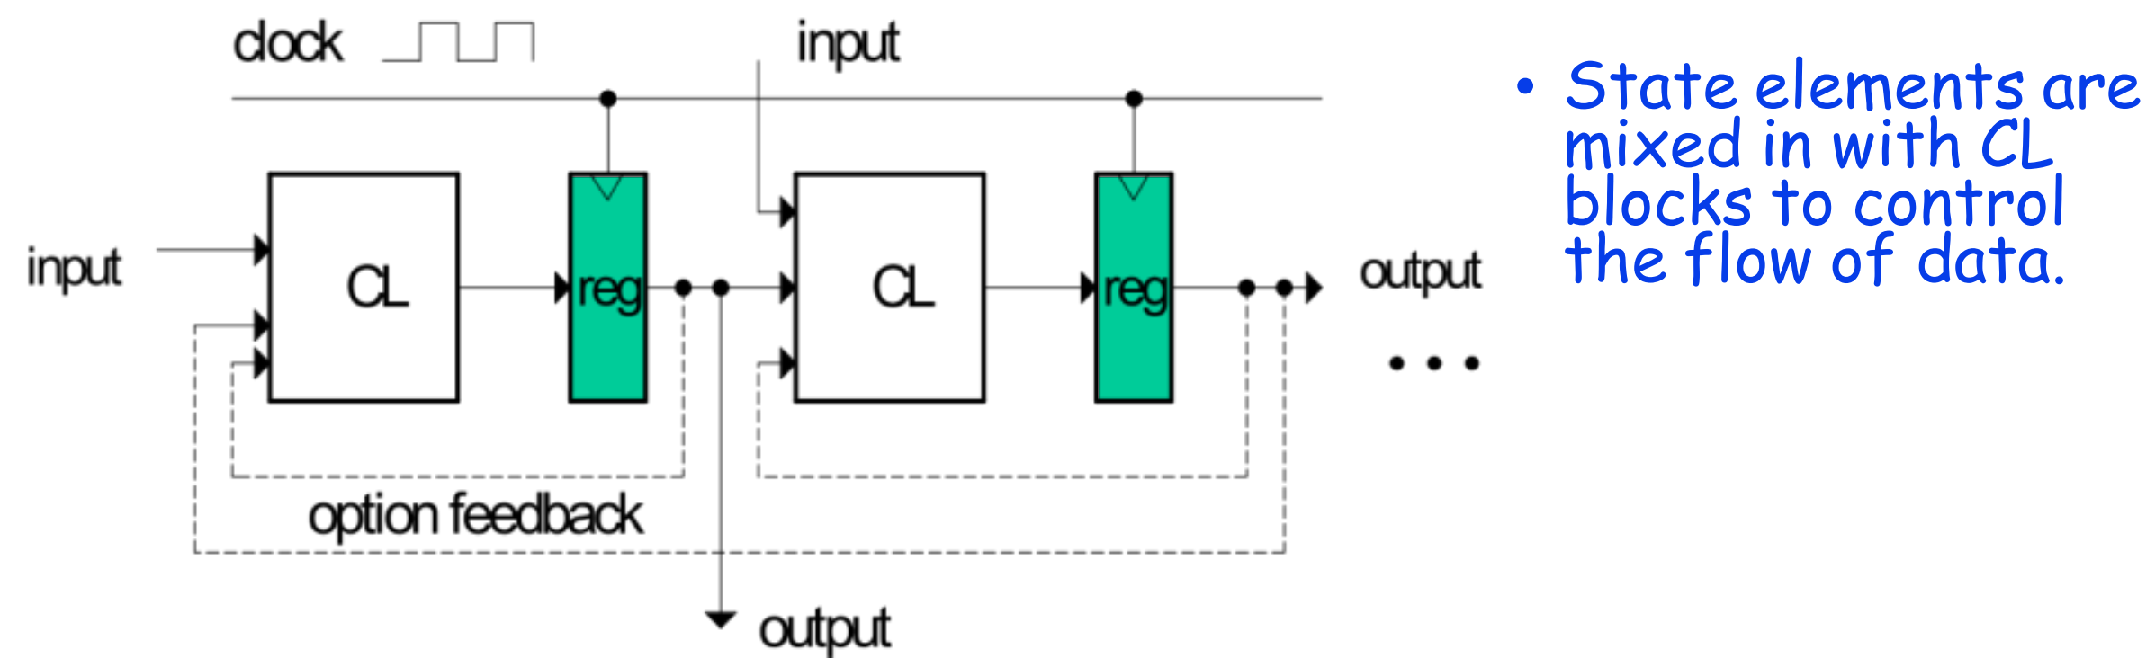
同步时序电路

Slide 103
One Standard High-level Template

Slide 104
数据通道设计实例

Slide 105
数据通道设计实例

Slide 106
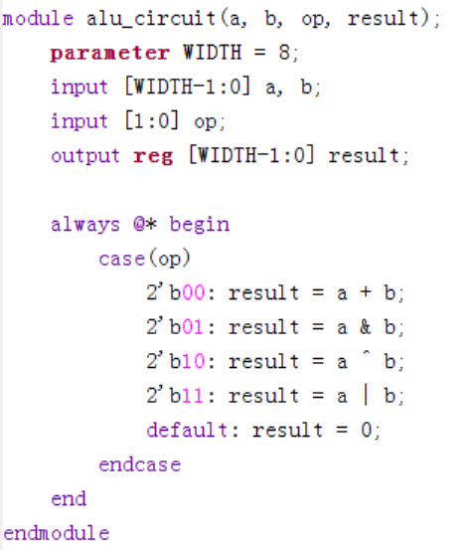
数据通道设计实例

Slide 107
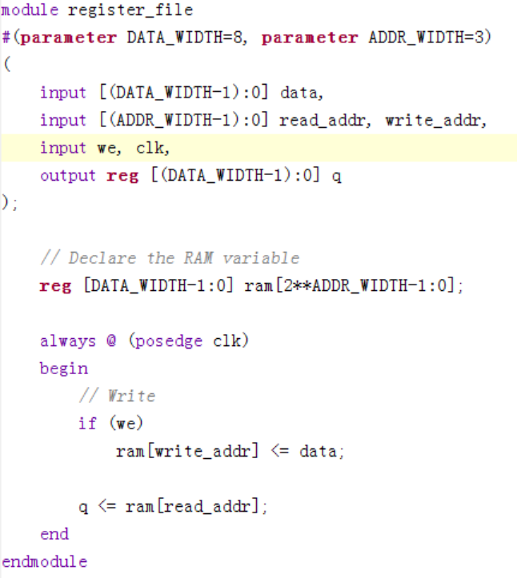
数据通道设计实例

Slide 108
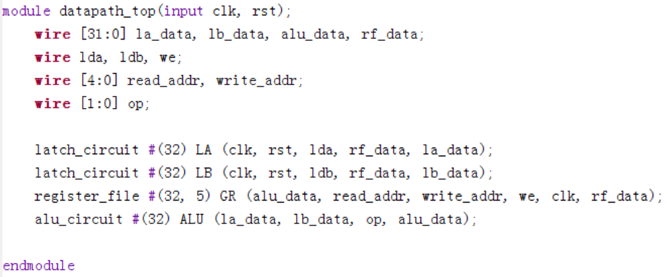
数据通道设计实例

Slide 109
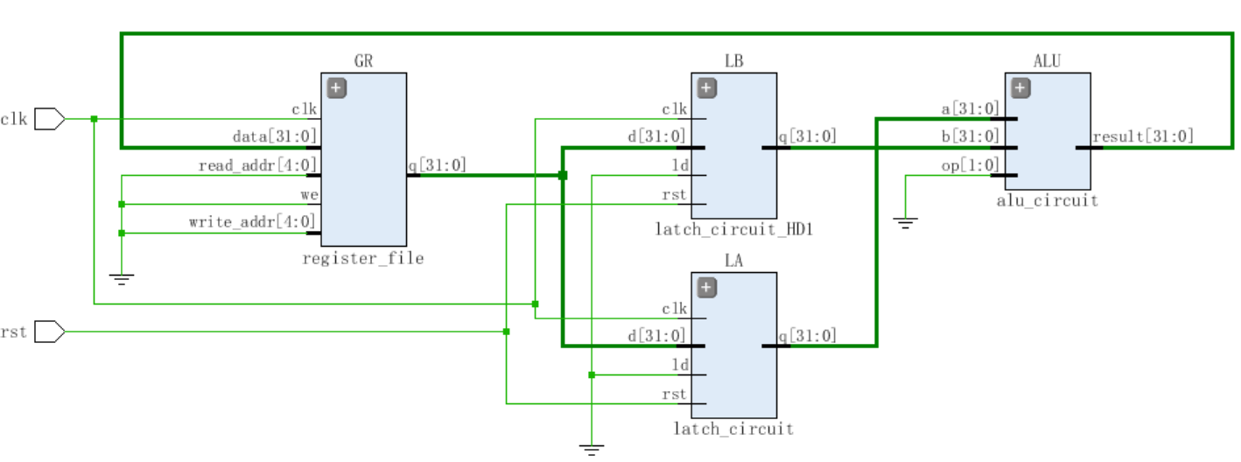
数据通道设计实例

Slide 110
有限状态机（FSM）设计

Slide 111
有限状态机（FSM）设计
用同步时序电路来实现FSM

Slide 112
有限状态机（FSM）设计

Slide 113
有限状态机（FSM）设计

Slide 114
有限状态机（FSM）设计

Slide 115
有限状态机（FSM）设计
Describing Safe FSMs in Verilog HDL
...
reg [1:0] State, StateNext;
always @(State, B) begin
case (State)
S_Off: begin
X <= 0;
if (B == 0)
StateNext <= S_Off;
else
StateNext <= S_On1;
end
S_On1: begin
X <= 1;
StateNext <= S_On2;
end
S_On2: begin
X <= 1;
StateNext <= S_Off;
end
default: begin
X <= 0;
StateNext <= S_Off;
end
endcase
end
...

Slide 116
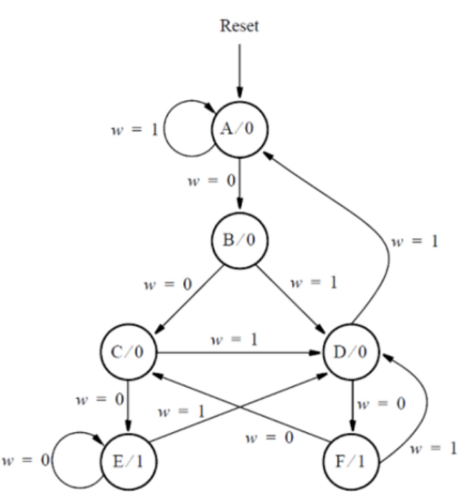
有限状态机FSM设计示例

Slide 117
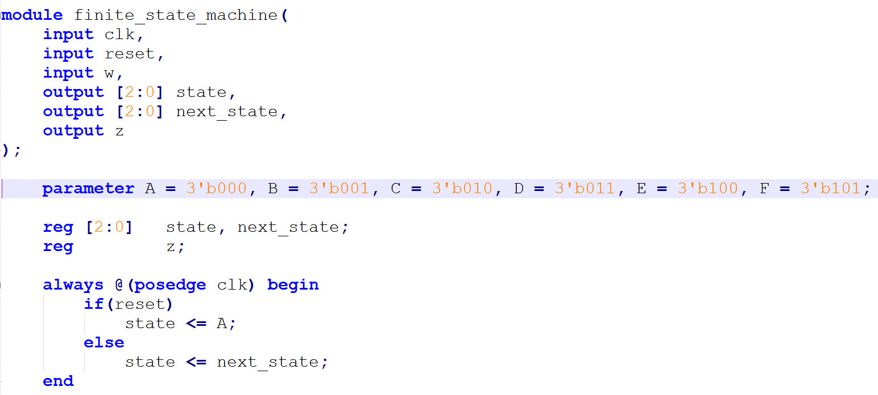
有限状态机FSM设计示例

Slide 118
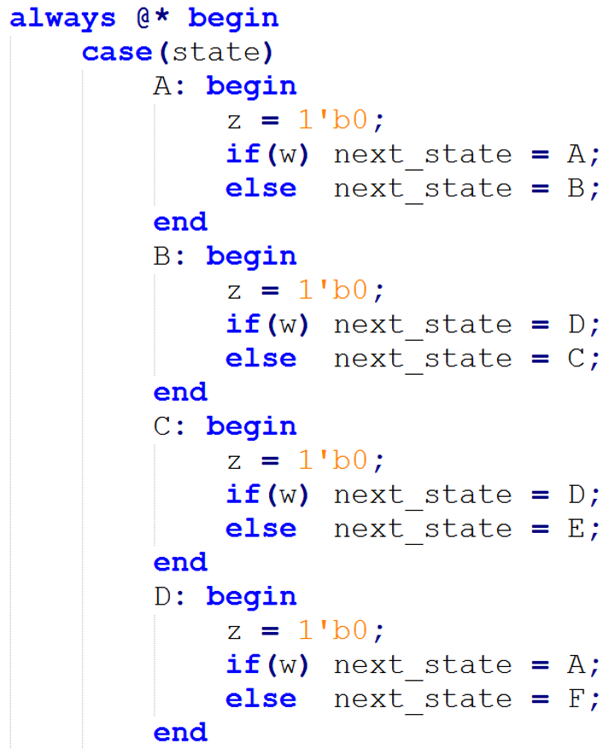
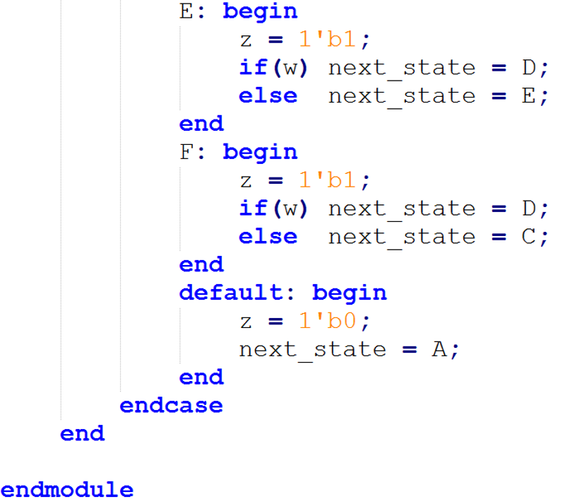
有限状态机FSM设计示例

Slide 119
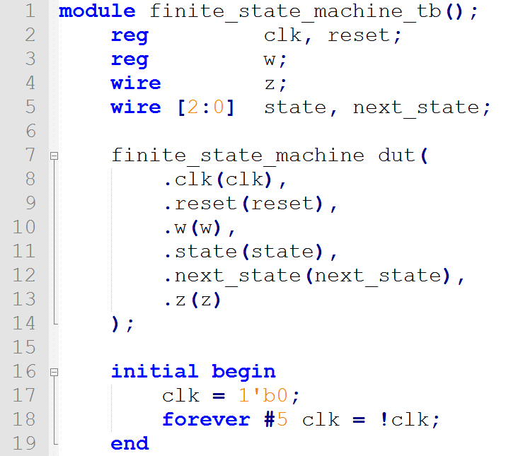
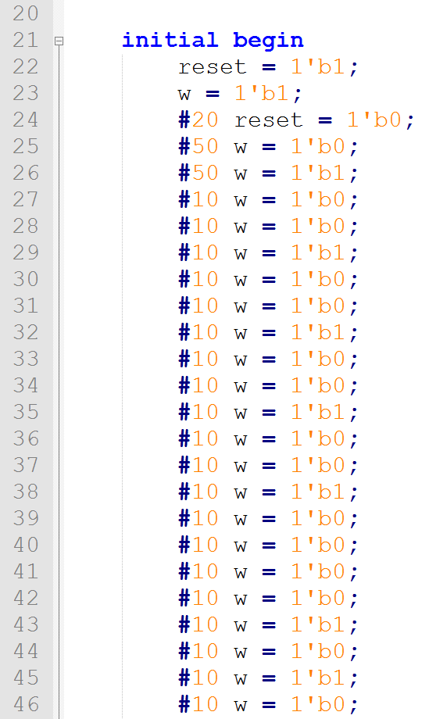
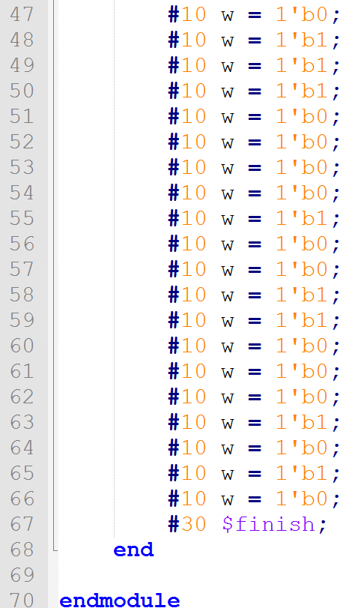
有限状态机FSM设计示例

Slide 120
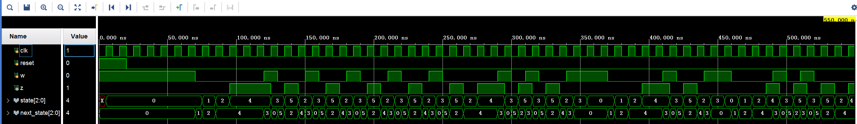
有限状态机FSM设计示例

